Slide 1

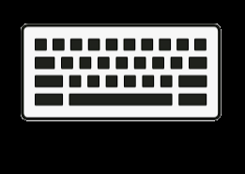

Mover
User Inputs
InputManager
Rotator
…

